Slide 1
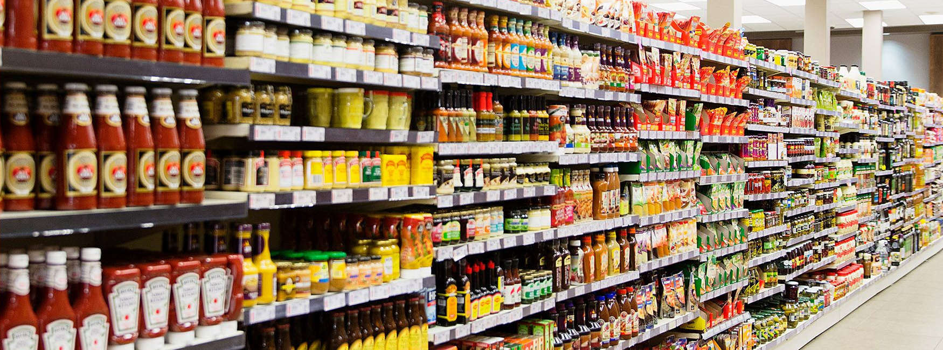
Food deserts’ impact on covid-19 metrics in Chicago
By Manli Patel, Jen Krizman, and Roxanne Meyer

Slide 2
Does grocery store availability impact covid-19 outcomes in Chicago?
While there are many compounding factors as to why specific zip codes had higher Covid-19 infection rates, we wanted to analyze if the amount of grocery stores was correlated to these outcome. We hypothesized that grocery stores, in part, have a positive impact on a zip codes’ health, which has showed to impact a populations’ COVID-19 outcome. Additionally, grocery stores have the ability to administer COVID-19 vaccinations, boosters and tests, which could positively affect a zip codes’ COVID-19 infection rates.

Slide 3
DATA Sources
US Census for Chicago (API)
City of Chicago Data Portal
Zip Code Listing
Grocery Store Status (From June 2020)
COVID-19 Hospitalizations and Deaths (Cumulative From March 2020 to July 2023)

Slide 4
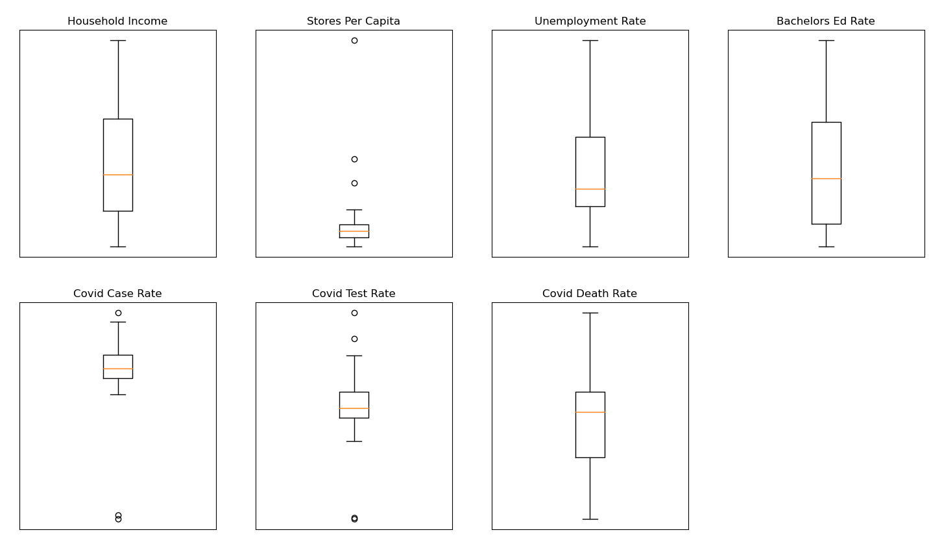
Data Distribution
Outliers were removed per analysis
Notes:
boxplots of the variables that we used in our analyses. we didn't exclude all outliers outright, but on a per-analysis basis

Slide 5
Hypothesis 1
Within Chicago zip Codes, zip codes with higher than average household income will have more grocery stores than zip codes with lower than average household income
Rationale: Businesses are more likely to build in areas where individuals have more disposable income to spend on their products and services

Slide 6
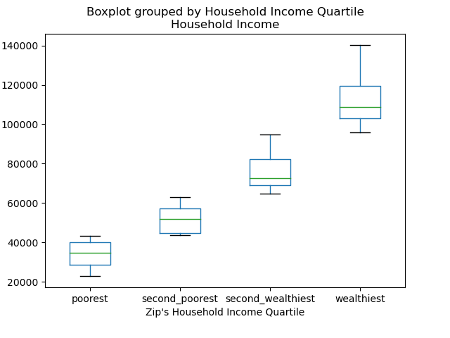
Hypothesis 1 Data
$140,125
$95,676
$95,676
Box Plot
Used bins to put the zip codes in one of 4 bins based on that zip code’s average household income
$63,889
$63,889
$43,440
$43,440
$23,019
Notes:
The purpose of those box plot was to show how skewed Chicago zip codes are in average household income. I have labeled the box plots, but this gives a nice representation of how for the first 2 quartiles of Chicago zips by average household income, they have very similar spreads from their mins to maxes of about $20K, but the upper middle class (or second wealthiest group) has a wider spread of 31.8K, and the wealthiest zips have a very wide spread at 44.4K.
Given this insight, I would anticipate that the right side of the scatterplot of annual household income vs grocery stores per capita will be quite spread out compared to the lower income zips. There also may be more variance in the higher income zips.

Slide 7
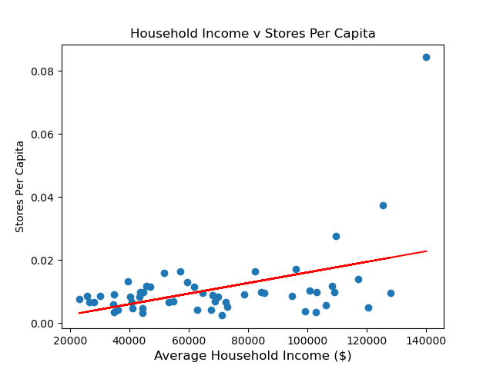
Hypothesis 1 Data(cont.)
Scatter Plot with Regression
The Regression line is modeled by the equation y = 1.679e-07x + -0.0007651913
The r-value is: 0.44475023404704944
The p-value is: 0.0007531819043198361
Notes:
I then created said scatter plot and we can see that those predictions were correct. Note how the points for average household income less than $90K are very tightly grouped close to the regression line. But once you get to the wealthiest zip quartile of $95K and greater, the variance is greater and the data points are much more spread out.
Overall, we found the r –value to be .445 which means there is a moderate, positive relationship between a zip code’s average household income and the number of stores per capita. There seems to be at least one outlier (at the highest zip), but there could be simple explanations for that, such as having a few grocery stores that are right on the boarder of their zip code and the next zip code.
Additionally, because the p-value is less than .05, these findings are significant.
We also noted that this data may be even better modeled by an exponential curve, but we have yet to learn that coding to test.

Slide 8
Hypothesis 2
Within Chicago zip codes, lower income areas will have higher rates of COVID-19 than higher income areas
Rationale: Lower Income areas have several contributing factors leading to these higher rates:
Less access to healthcare
Lowered ability to afford healthcare which may mitigate COVID-19 transmission
Notes:
Within Chicago zip codes, lower income areas will have higher rates of covid 19 than higher income areas. Our rationale is that lower income areas have several contributing factors leading to these higher rates which are lower access to healthcare and a lowered ability to afford healthcare which may mitigate COVID-19 transmissions.
To help prove this we made some figures comparing the Covid test rates, covid case rates, and covid death rates with the average household income.

Slide 9
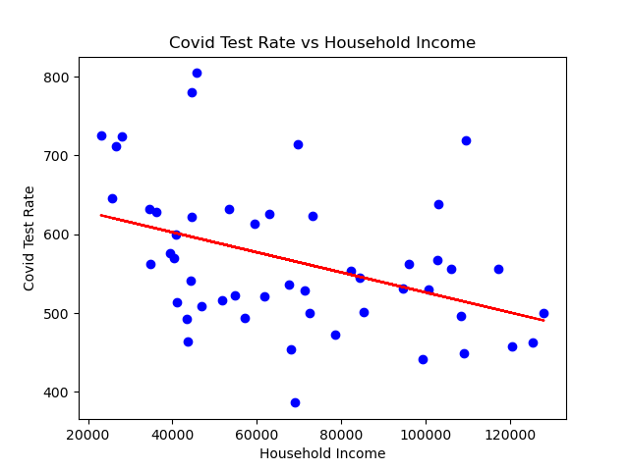
Hypothesis 2 Data
R value: -0.4099
Regression line eq: y=-0.0012707x+653.44
Notes:
We first graphed a scatterplot comparing covid test rates with household income and we noticed that the higher income areas had a lower test rate compared to the lower income areas. The r-value is -0.4099 which means there is a negative relationship and it is not exactly a linear relationship.

Slide 10
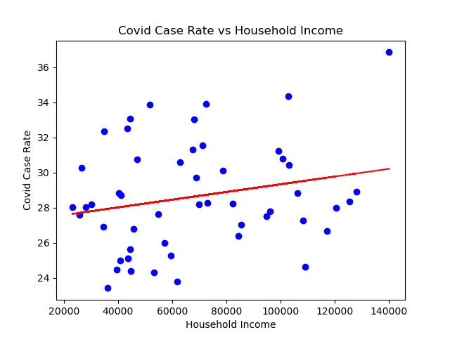
Hypothesis 2 Data(cont.)
R-value: 0.22351
Regression Line equation: y=2.19e^-5x+27.14
Notes:
We also graphed a scatterplot comparing the covid case rate with household income. The r-value is 0.2235 which means a positive relationship but not a good linear relationship but there is still a small pattern. The higher income areas have more positive cases.

Slide 11
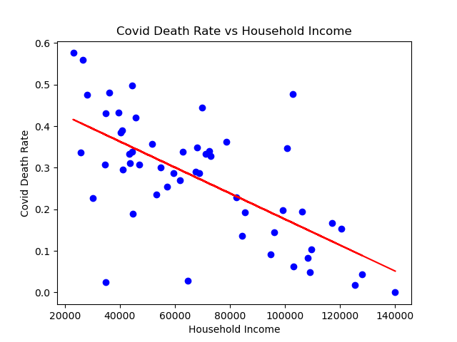
Hypothesis 2 Data(cont.)
R-value: -0.66243
Regression Line equation: y=-3.1e^-6x+0.49
Notes:
We graphed a scatterplot comparing the covid death rate with household income. The r-value is -0.6624 which means a negative relationship and it has a more linear relationship compared to the other 2 graphs. There is a significant difference between higher income and lower deaths. When comparing the data from all 3 scatter plots we can see that even though the lower income areas had a higher test rate and a lower case rate they still had a very high death rate showing that the limited access to healthcare could have been a case for this difference.

Slide 12
Hypothesis 3
Food insecurity adversely impacts covid outcomes by limiting access to healthy food options and in-pharmacy medical care (e.g., vaccinations)
Predictions.
Across zip codes in the Chicago area, those with fewer grocery stores report higher covid cases, tests, and covid-related death
A median-split of zip codes further supports this grocery-store availability/covid link
The correlation between store availability and covid rates cannot be explained by other variables, namely employment status and education demographics

Slide 13
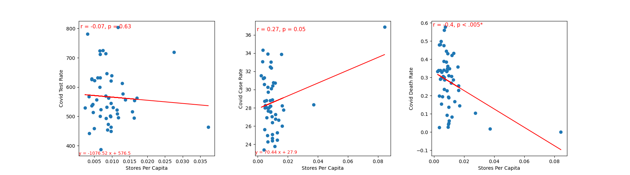
Hypothesis 3 Data
Covid Test Rate
Covid Case Rate
Covid Death Rate
Notes:
Please note: there are 3 hidden figures on this slide, viewable when animations are present

Slide 14
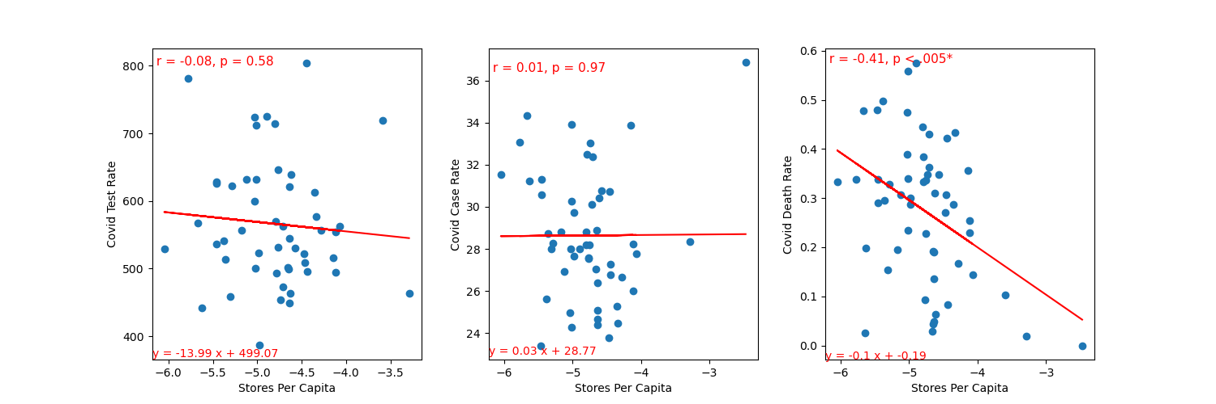
Hypothesis 3 Data
Covid Test Rate
Covid Case Rate
Covid Death Rate
Notes:
Please note: there are 3 hidden figures on this slide, viewable when animations are present

Slide 15
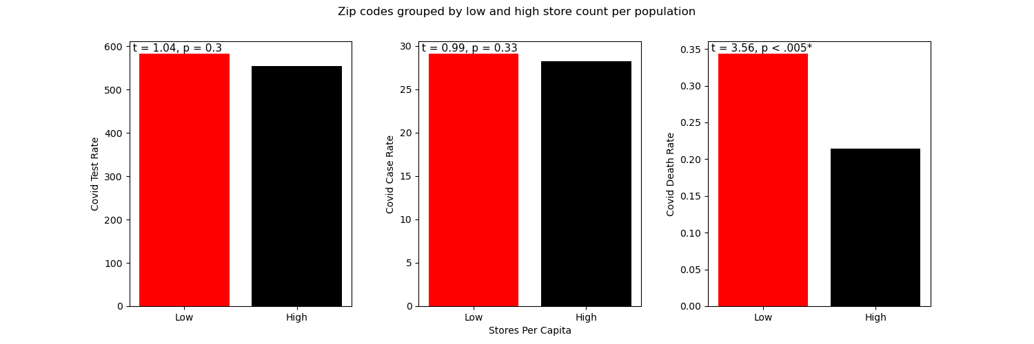
Hypothesis 3 Data
Covid Test Rate
Covid Case Rate
Covid Death Rate
Notes:
Please note: there are 3 hidden figures on this slide, viewable when animations are present

Slide 16
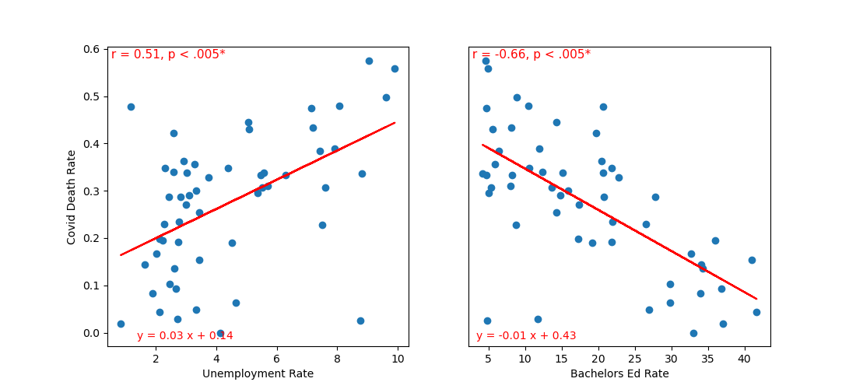
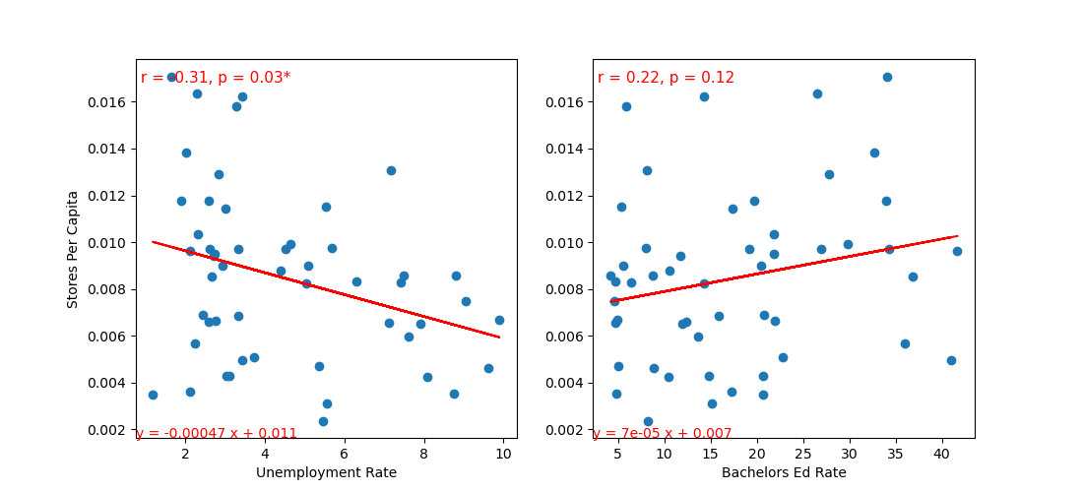
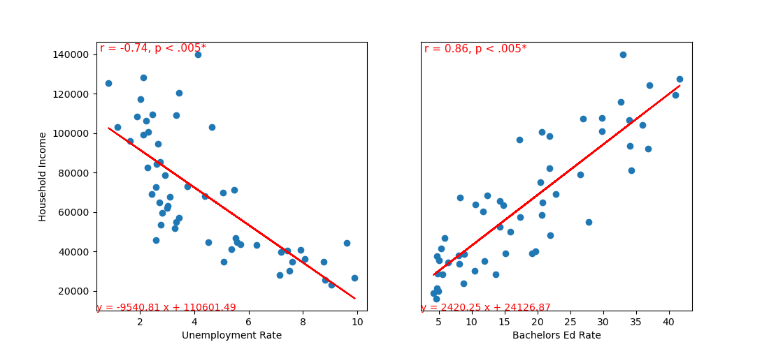
Hypothesis 3 Data
Covid Death Rate
Stores Per Capita
Household Income

Slide 17
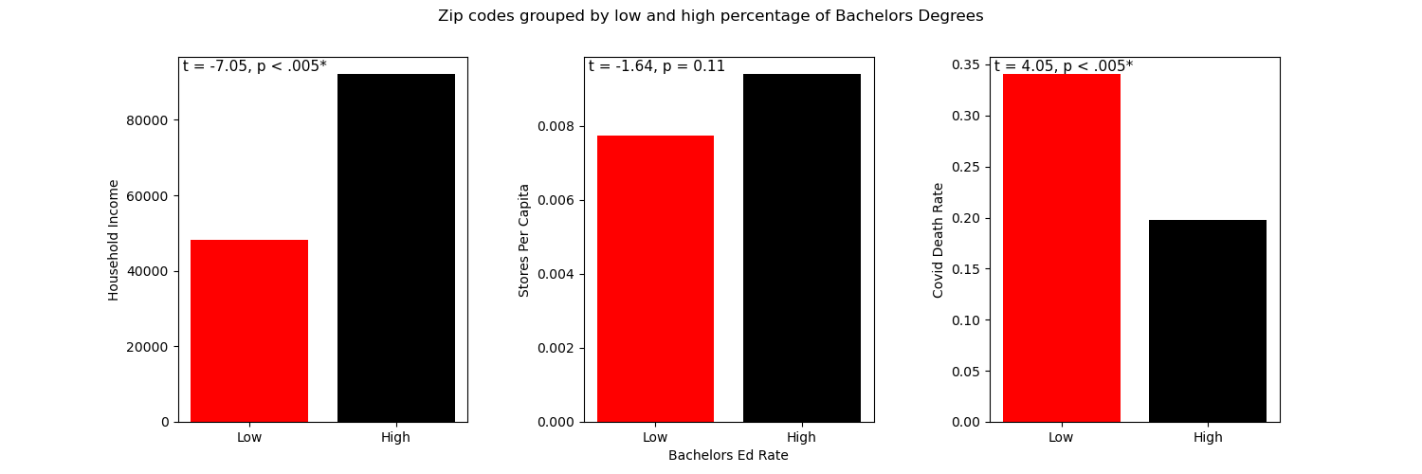
Hypothesis 3 Data
Household Income
Stores Per Capita
Covid Death Rate

Slide 18
Conclusions
Hypothesis 1: Zips w/ higher average household income will have more grocery stores per capita than zip codes with lower average household income
Hypothesis 2: Within Chicago Zip Codes, lower income areas will have higher rates of COVID-19 than higher income areas
Hypothesis 3: Food insecurity adversely impacts covid outcomes by limiting access to healthy food options and in-pharmacy medical care (e.g., vaccinations)
Causality – more stores may have closed due to covid
Unemployment rate and education status may be influencing some of these relationships. A multivariate regression including all factors is warranted

Slide 19
Implications of the analysis
Food insecurity may be linked to covid transmission and death rates
Also see Choi & Men; Public Health, 2021
Previous work has shown strong links between food insecurity and chronic health conditions (e.g., see Carter et al., Ref Mod in Biomed Sci, 2023)
Our findings suggest that access to quality food may adversely impact those who are food insecure on pandemic outcomes
Findings linking employment and education status to covid rates suggests that a multitude of socioeconomic factors can influence health during a pandemic

Slide 20
Questions?

